Slide 1
Project Title : Nexusmart(An Integrated Classroom Management System)
DEPARTMENT OF CSE-AIML (CSM) – III-I Sem
E2E Project Review - 1
Batch #:2
Team Members (Regd #) : III – I :: CSM – C
1.Paruchuri Naga Sai Ruthwik - 21BQ1A42D8
2.Yaddanapudi Bindu Varsha - 21BQ1A42I2
3.Vuha Chandrika Ippala - 21BQ1A42I1
4.Sangisetty Deepika - 21BQ1A42F6
5.Raavi Chandu - 21BQ1A42F0
6.Popuri Rishitha - 21BQ1A42E5
7.Somu Nandini - 21BQ1A42G6
8.Podila Sai Niharika - 21BQ1A42E4
9.Paleru Anudeep - 21BQ1A42D7
10.Vegi Charan Sai Venkat - 21BQ1A42H9
11.Srungarapati Deepika - 21BQ1A42G7
12.Miriyala Kiranmai - 21BQ1A42D1
13.Parasa Hari Sai - 22BQ5A4213
14.Seelam Siva Sai Giri - 22BQ5A4216
15.Challa Srishanth - 21BQ1A42I7
Project Guide:
SK.Sameerunnissa,
Associate Professor,
Dept.of CSE,
VVIT

Slide 2
Project Title : Nexusmart(An Integrated Classroom Management System)
DEPARTMENT OF CSE-AIML (CSM) – III-ISem
E2E Project Review - 1
Batch #:2
Project Description:
Our Web Application offers a comprehensive solution to challenges faced in educational environments.
By integrating attendance management, student information storage, note sharing, class scheduling, and a CGPA calculator, our application enhances the overall teaching and learning experience.
The use of Material Design ensures an elegant and user-friendly interface.
Our application aims to bridge the gap between administrative tasks and academic resources, providing educators and students with a powerful tool to streamline their tasks and enrich their educational journey.
Project Functional Requirements: (Features)
News And Events
Student Information Storage
Course Enrollment Analysis
Branch Wise Students Performance Analysis
Assessment , Grading and Report Generation
Student Course Enrollment
Customized Quizzes
Upload video and Documentations for each Course
Attendance Management
Recent Activity Tab
PDF Generator for Students Grade Report and Course Documentation
Semester Info and Scheduling
User Authentication and Management
Session Management and Time Table Info

Slide 3
Project Title : Nexusmart(An Integrated Classroom Management System)
DEPARTMENT OF CSE-AIML (CSM) – III-I Sem
E2E Project Review - 1
Batch #:2
Project Tools Required:
1. Frontend Development:
- HTML
- CSS
- JavaScript
- Django Templates (for integration with the Django backend)
2. Backend Development:
- Django Framework: This includes Django REST framework if you are building APIs.
- Python (Django is a Python web framework)
3. Database Development:
- PostgreSQL: This is the chosen database management system.
4. Version Control:
- Git: To manage and track code changes, collaboration, and version history.
5. Integrated Development Environment (IDE):
- Visual Studio Code
6. Design and Prototyping (Optional):
- Figma
7. Deployment and Hosting:
- Server infrastructure for hosting the application like AWS, Azure, or Heroku.
- Docker and container orchestration tools like Kubernetes for containerization and scaling.
Project Tasks -Team member Allocation Feature
Tasks Team member
1.Frontend - 21BQ1A42I2
21BQ1A42D7
21BQ1A42H9
21BQ1A42G7
21BQ1A42D1
2. Backend - 21BQ1A42D8
21BQ1A42F0
22BQ5A4213
22BQ5A4216
21BQ1A42I7
3. Database - 21BQ1A42I1
21BQ1A42F6
21BQ1A42E5
21BQ1A42E4
21BQ1A42G6

Slide 4
Project Title : Nexusmart(An Integrated Classroom Management System)
DEPARTMENT OF CSE-AIML (CSM) – III-I Sem
E2E Project Review - 1
Batch #:2
Team Member | Features Assigned | Tasks to Compleate
Yaddanapudi Bindu Varsha | 1.Implement the user interface with HTML, CSS, and JS 2. Develop frontend components using Django templates | 1. Learn HTML, CSS, and JavaScript 2.Create responsive and user-friendly UI 3.Integrate frontend with Django views and templates
Paleru Anudeep
Vegi Charan Sai Venkat
Srungarapati Deepika
Miriyala Kiranmai
Paruchuri Naga Sai Ruthwik | Develop backend functionality using Django framework | 1.Develop API endpoints for various features. 2.Implement user authentication and management 3.Integrate with frontend for seamless user experience
Raavi Chandu
Parasa Hari Sai
Seelam Siva Sai Giri
Challa Srishanth
Sangisetty Deepika | 1.Design and implement the database using PostgreSQL 2.Integrate database with Django models | 1.Learn PostgreSQL and database design 2.Create and maintain the database schema 3.Ensure data integrity and efficient queries
Vuha Chandrika Ippala
Popuri Rishitha
Somu Nandini
Podila Sai Niharika
Project Tasks -Team member Allocation

Slide 5
Project Title : Nexusmart(An Integrated Classroom Management System)
DEPARTMENT OF CSE-AIML (CSM) – III-I Sem
E2E Project Review - 1
Batch #:2
Team Member | Tools Learning | Status (Certification / Non Certification)
Yaddanapudi Bindu Varsha | HTML, CSS, JavaScript, Django | Certification
Paleru Anudeep
Vegi Charan Sai Venkat
Srungarapati Deepika
Miriyala Kiranmai
Paruchuri Naga Sai Ruthwik | Django | Certification
Raavi Chandu
Parasa Hari Sai
Seelam Siva Sai Giri
Challa Srishanth
Sangisetty Deepika | Django, PostgreSQL | Certification
Vuha Chandrika Ippala
Popuri Rishitha
Somu Nandini
Podila Sai Niharika
Project Team member Learning Status:

Slide 6
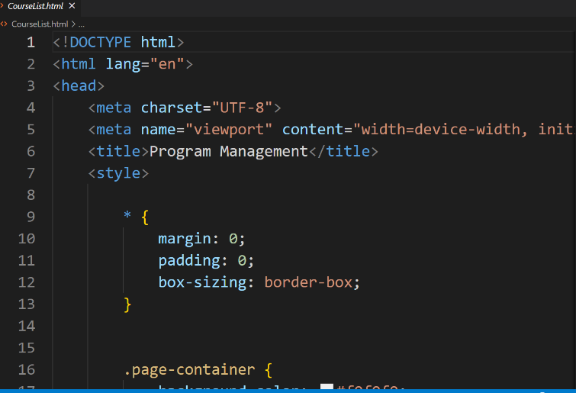
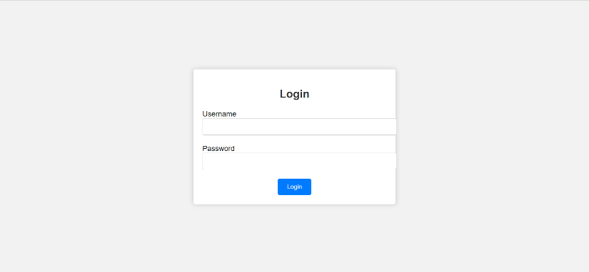
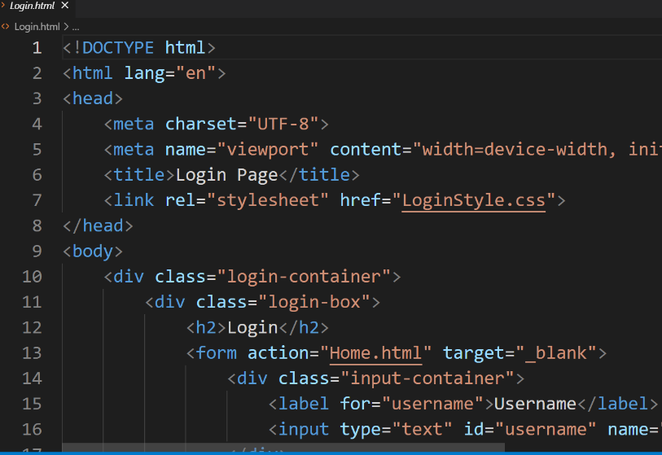
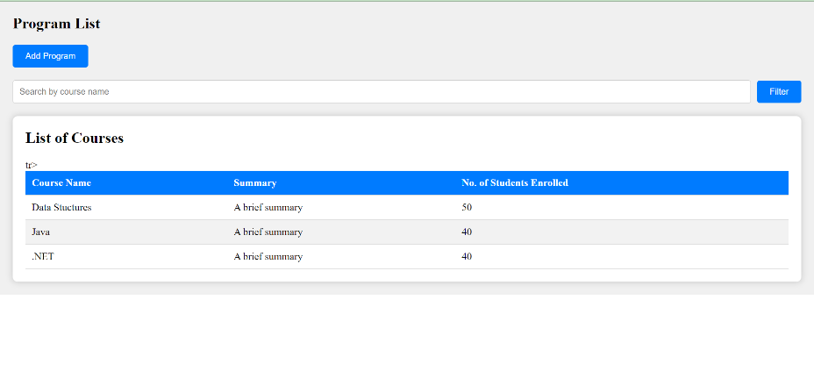
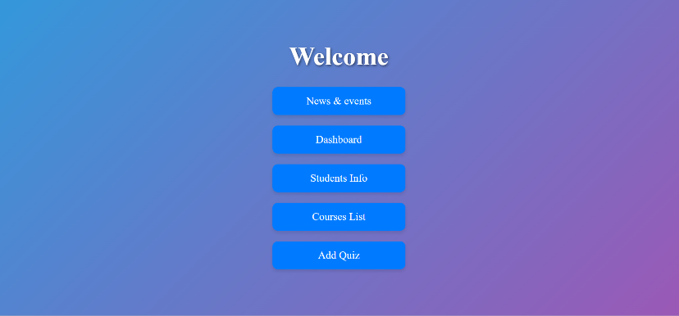
Project Title : Nexusmart(An Integrated Classroom Management System)
DEPARTMENT OF CSE-AIML (CSM) – III-II Sem
E2E Project Review - 1
Batch #:2
Project Tasks –Implementation Status Screen Shots & <<Code Ready>>

